Slide 2
Chronic Disease and Remote Patient Monitoring in the United States
Marcus Grindstaff
Chief Operating Officer
Care Innovations, an Intel® Company
December 9, 2016

Slide 3
Chronic Disease in the United States
Many chronic conditions are behavior driven.
One of the most common, preventable, and costly of all health problems.
117 million Americans with chronic health conditions (2012), growing to 171 million (2030).^{1,3}
AHRQ mapping of 58 systematic reviews demonstrates “substantial evidence” supporting “remote patient monitoring for chronic conditions”. “The focus should shift from effectiveness studies to broader implementation efforts…”¹⁰

Slide 4
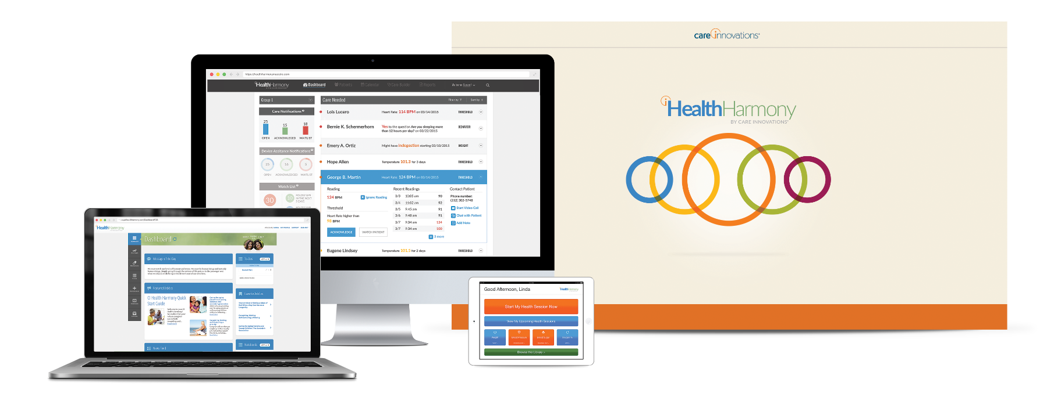
Virtual Consultation and Remote Patient Monitoring
Virtual Consultation
Point-of-care replacement.
Bridges “distance” using video technology.
Makes existing care model more convenient.
Remote Patient Monitoring
Care model evolution – manages chronic conditions.
Reduces costs by reducing acute care utilization.
Delivers behavior change – delivers lasting change.
Least restrictive setting – the home.
Helps providers anticipate and address issues before they become an emergency.

Slide 5
Remote Patient Monitoring – 90 Day Program
Acute Physiological Monitoring
Phase 1
Transition to Self-Management
Phase 4
Behavior Change
Phase 3
Adherence
Phase 2
Phase 1 | Monitoring signs and symptoms Identify resources needed | Phase 3 | Disease process education Support for changing behavior
Phase 2 | Learn new medical regimen Medication management and adherence | Phase 4 | Learn & model self-management behaviors Demonstrate self-monitoring and response

Slide 6
Department of Veterans Affairs
Care Coordination Home Telehealth Program - Veteran Care
⁵
Bed Days of Care Reduced by 25%
Hospital Admissions Reduced by 19%
Patient Satisfaction Increased by 86%
The VA runs the largest and most successful RPM program in the world.
Many thousands of Veteran patients are regularly using home telehealth devices to coordinate their care. VA finds that patients easily learn how to use these devices and are highly satisfied with Home Telehealth.⁶
⁵
⁵

Slide 7
Ascension Health System
Indianapolis, IN - Beacon Grant Program
The patient who has benefited the most from the program is a 53-year-old woman with nine chronic conditions, 11 admissions in 2011 and total hospital costs of $156,000 for that year.
“We enrolled her on Dec. 20 and seven months later, she had not been back to the hospital room.”
- Dr. Alan D. Snell, Chief Medical Informatics Officer.⁷
Readmissions Reduced by 64%
Intervention group compared to the study control group.
Patient Activation Measures 18% Higher
Intervention group compared to the study control group.
Patients taking control of their conditions drives lower costs.

Slide 8
Nationwide “Top-5” Medicare Advantage Payer
Congestive Heart Failure RPM Program
⁸
Admissions Reduced by 40%
vs. non-enrolled patients +73%.
Readmissions Reduced by 32%
vs. non-enrolled patients +88%.
ER Utilization Reduced by 29%
vs. non-enrolled patients +31%.
Total Medical Expenses Reduced by 26%
vs. non-enrolled patients +44%.
“What makes this program so special is that customers know they have easy and direct access to a [our] nurse practitioner, someone who truly cares about them and their health. They feel empowered to learn how they can impact their own health.”⁹
- Health Plan, Senior Medical Director
⁸
⁸
Program is expanding. Medicare Advantage proving ground for new care models is delivering results.
⁸
Notes:
These are not “published”, nor are they the result of a rigorous and validated study. But… they are Cigna’s internal numbers and something Dr. Edgeworth has shared publically. Marcus will have to use some discretion, maybe something like “Cigna has reported significant savings from their CHF program.” Cigna HealthSpring compared CHF members on HH, with CHF members not on HH during the same timeframe. For example, CHF members on HH showed a 29% reduction in ER utilization, while CHF members not on HH showed an increase of 31% in ER utilization.

Slide 10
Chronic Care Coordination - Senate Finance
Section 101: Extending Independence at Home Act
Retain RPM and telehealth from original legislation that has been so successful.
Section 303: Increasing Convenience for MA Enrollees
Include remote monitoring and telemonitoring (term from Medicare Advantage manual) to provide important flexibility for MA plans that now must plan for and develop remote monitoring and telemonitoring as a supplemental benefit.
Section 304: Providing ACOs with the Ability to Expand Telehealth
Include remote monitoring to provide important flexibility for ACOs which now are restricted by outdated policies limiting communications for care coordination.
Notes:
Making it easier for at-risk entities to deploy remote monitoring, keep people in their homes and reduce costs

Slide 11
Connect For Health - Bi-Partisan and Bi-Cameral
Over 100 endorsements from patient groups and industry.
Section 201: Telehealth and RPM Services Furnished by Qualifying APM
Submit reports for evaluation by the Secretary.
No Increase In Expenditures - If the Secretary determines payments for telehealth or RPM services under this section will increase expenditures under this title, the Secretary shall make adjustments to such payments to eliminate such increased expenditures.
Section 301: Provision of RPM for Chronic Disease Patients
Guardrails - under supervision of a provider:
2 of more chronic diseases
2 or more hospitalizations related to the chronic diseases over the past year
Quality requirements
Duration - 90 day period - physician can renew
Notes:
Provide guardrails to ensure rpm targeted at right patients

Slide 12
Citations
¹ http://www.cdc.gov/chronicdisease/overview/
² Wu, Shin-Yi, and Green, Anthony. Projection of Chronic Illness Prevalence and Cost Inflation. RAND Corporation, October 2000.
³ http://www.altfutures.org/pubs/PH2030/PH2030_Chronic_Disease_Driver_Forecasts_2014.pdf
⁴ http://www.cdc.gov/chronicdisease/about/multiple-chronic.htm
⁵https://www.ncbi.nlm.nih.gov/pubmed/19119835
⁶ http://www.telehealth.va.gov/ccht/
⁷ http://medcitynews.com/2012/09/beacon-trial-reduced-readmits-of-heart-patients-to-3-using-home-video-conferences/
⁸ C-Spire Telehealth Summit in Jackson, MS on Sept 8, 2016
⁹ http://www.mobihealthnews.com/37075/cigna-intel-ge-expand-rpm-trial-for-medicare-heart-patients
¹⁰ Telehealth: Mapping the Evidence for Patient Outcomes From Systematic Review (Agency for Health Research and Quality)

