Slide 1
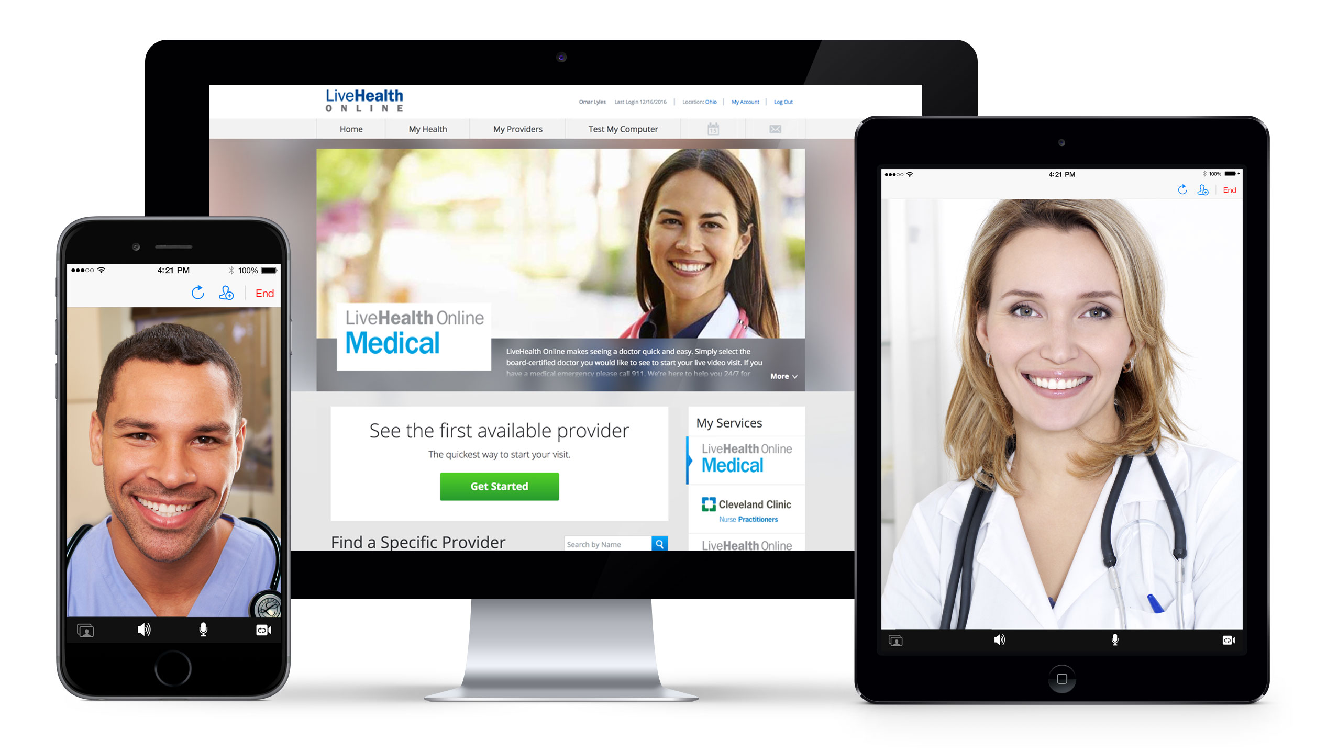
LiveHealth Online goes where you go
The LiveHealth Online app is available on both iOS and Android
Access LiveHealth Online via smart phone, tablet or computer

Slide 2
LiveHealth Online | Medical

Slide 3
The features of LiveHealth Online Medical
Live, on-demand video doctor visits 24x7/365
Accessible by smartphone, tablet or computer
Cost is less than or equal to your office visit
Available in all states with an average wait time of 10 minutes
Choice of board certified, Anthem network doctors
Secure and private, HIPAA compliant video visit
E-prescribing to your pharmacy of choice*
Available to Anthem members and non-members
*Only non-controlled substances can be prescribed via video doctor visits

Slide 4
Commonly Treated Medical Conditions
Abrasions, minor wounds
Acne
Anxiety
Asthma
Allergies/allergic rhinitis
Back pain
Cough/Cold
Depression
Diabetes/hypoglycemia
Diarrhea
Ear pain
Fever
Headache/migraine
Hypertension
Incontinence
Incontinence
Influenza/flu
Insomnia
Nausea/Vomiting
Obesity
Pinkeye and other eye infections
Rashes/skin disturbances
Sinus infection
Smoking cessation
Sore throat/pharyngitis
Sprains and strains
Urinary tract infection
Access

Slide 5
LiveHealth Online Medical – Quick and easy access to doctors
Emergency Room
Time: 3+ Hours Cost: $1,636
Impact: Time spent driving and waiting to be seen. Had to wake up the other children. Had to take off the following day of work.
Meet Karen
(3 Children)
Three children are sleeping and one wakes up in the middle of the night crying with a fever and a bad cold. Husband is out of town. She wants to talk to a doctor but it’s 2 am. What should she do?
Urgent Care Center
Time: 2+ Hours Cost: $147
Impact: Time spent driving and waiting to be seen. Had to wake up the other children. Tired and dragging the next day at work.
LiveHealth Online
Time: 10 min or less wait Cost: $49 or less
Impact: No driving, no appointments, no long waits. No time off from work. Child feels better faster!
National average allowed amounts; 2016 claims data based on Local Group and Individual, Non Refunding Members only, for LiveHealth Online fully treatable diagnosis codes in Anthem's 14 Blue states

Slide 6
Employer benefits- Saving money for the employee and employer*
Emergency Room
Urgent Care
Doctor’s Office
Retail Clinic
LiveHealthOnline
$1,636
$147
$105
$82
$49
*National average allowed amounts; 2016 claims data based on Local Group and Individual, Non Refunding Members only, for LiveHealth Online fully treatable diagnosis codes in Anthem's 14 Blue states
Cost of Care

Slide 7
A great consumer experience
94% Visit Satisfaction Rating
“I absolutely love this service! I have used others like Teladoc in the past, but this is much more personalized.”
96% Doctor Satisfaction Rating
“It’s amazing to have access to a doctor anytime, anywhere for a modest fee.”
73% Saved 2 Hours or More
“Much quicker then the emergency room or urgent care and felt more personable.”
Source: LiveHealth Online 2016 Post-Visit Survey Data

Slide 8
Video visits with Spanish speaking doctors
Cuidado Médico on LiveHealth Online:
Scheduled visits between 7am-11pm, 7 days a week
Same day appointments, in most states
Connect via the LiveHealth Online mobile app
Video visit provides access to in network, board certified Spanish speaking doctors
Secure, convenient and easy-to-use
Prescriptions sent directly to the pharmacy of members choice
Accepts payments via Visa, MasterCard, American Express and Discover
Access
Convenience

Slide 9
LiveHealth Online | Psychology

Slide 10
Here’s how LiveHealth Online Psychology can help
Video visits with in-network licensed Psychologists & Therapists
Self-scheduled appointments, 7am - 11pm 7 days a week
Appointments available within 4 days or less
Private, easy to access and convenient
Available in 50 states
Access via smart phone, tablet or computer
Available for members age 10 & up
Days Before First Therapy Visit*
LiveHealth Online
4
New Adult Office Visit
New Child Office Visit
42
26
*https://www.naminh.org/sites/default/files/Summary%20Report%2004%2028%2014%20Waiting%20for%20Help%20FINAL2.pdf
Access
Convenience

Slide 11
Commonly Treated Behavioral Health Conditions
Stress
Anxiety
Depression
Relationship troubles
Parenting issues
Grief
Panic attacks
Coping with an illness
11
Access
Convenience

Slide 12
LiveHealth Online Psychology Member Feedback
96% Said provider was professional and helpful
95% Felt provider understood their concerns
90% Were able to book a visit using LiveHealth Online sooner than an office-based visit
Data is from the 2016 LiveHealth Online Psychology post visit survey.

Slide 13
11 Conditions of Interest

Slide 14
Follow Up Office Visits (Within 3 Weeks)
*Significantly different from LHO (when asterisk next to location, difference is for all follow up visits, when asterisk in the chart, difference is for follow up visits with similar diagnosis)
Notes:
Caveat that we don’t identify everything that is related

Slide 15
Cost-savings (Medical + Pharmacy Episode Cost)
For the 11 conditions of interest, on average:
RHC is 1.11x as expensive as visit on LHO
UCC is 1.45x as expensive as visit on LHO
ED is 6.35x as expensive as visit on LHO
PCP is 1.60x as expensive as visit on LHO
All in, Anthem, employers and/or members save an average of $201* per episode (including follow-up) for the 11 conditions of interest
*This assumes that patients who do nothing would not eventually need additional care, that patients would use the care they say they would, and that care would follow patterns described previously.

