Slide 1
State of Telemedicine
Hill briefing on new telemedicine evidence
December 9, 2016

Slide 2
Outline
The need for telehealth
Our work
Policy barriers

Slide 3
Outline
The need for telehealth
Our work
Policy barriers

Slide 4
At the turn of the century, the Institute of Medicine called for a paradigm shift in healthcare
Crossing the Quality Chasm
“The American health care delivery system is in need of fundamental change. Between the health care we have and the care we could have lives not just a gap, but a chasm.”
“This higher level of quality cannot be achieved by further stressing current systems of care. The current care systems cannot do the job. Trying harder will not work. Changing systems of care will.”
Source: Institute of Medicine (2001). Crossing the Quality Chasm. Washington, D.C.: National Academy Press

Slide 5
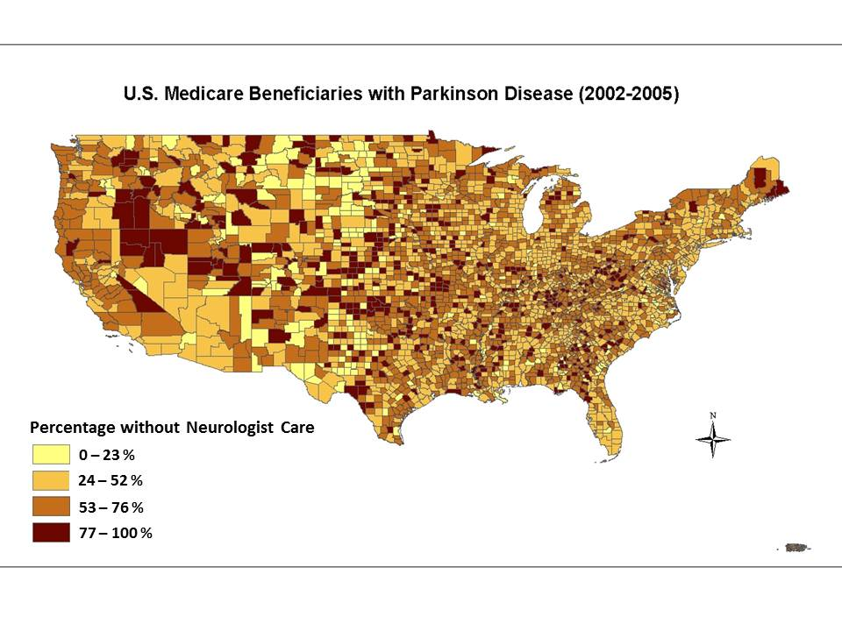
We are still working to cross this quality chasm today
Proportion of Medicare beneficiaries with PD who do not see a neurologist
Source: Neurology 2013; 80:1989-96.

Slide 6
In 1996, the Institute of Medicine identified telehealth’s potential to bridge this chasm
Number of publications citing “telehealth" since 1962
“With the nation’s health care system undergoing profound changes and experiencing relentless financial pressures, telemedicine is being investigated for its utility in urban as well as rural settings…telemedicine has the potential to radically reshape health care in both positive and negative ways and to fundamentally alter the personal face-to-face relationship that has been the model for health care for generations.” (IOM 1996)
Source: Institute of Medicine (1996). Telemedicine: A Guide to Assessing Telecommunications in Health Care. Washington, D.C.: National Academy Press

Slide 7
Outline
The need for telehealth
Our work
Policy barriers

Slide 8
Research increasingly demonstrates the benefits of telemedicine
Randomized controlled trials of telemedicine providing care into a patient’s home
Study (year) | Condition | N | Sites | Findings
National randomized controlled trial of virtual house calls for individuals with Parkinson disease (Connect.Parkinson) (2016) | Parkinson disease | 195 | 18 | Providing specialty care remotely into the homes of individuals with Parkinson disease was feasible and not more or less efficacious than usual care Interest and satisfaction with the care model was high Patients preferred virtual visits to usual in-person care
Randomized controlled clinical trial of “virtual house calls” for Parkinson disease. (2013) | Parkinson disease | 20 | 2 | Virtual house calls were feasible As effective as in-person care
A randomised trial of a remote home support programme for infants with major congenital heart disease. (2012) | Congenital heart defects | 83 | 2 | Clinicians were more confident in treating patients in video visits vs. telephone Parents were satisfied with video visits Healthcare resource utilization was lower in video-conferencing group
A new multidisciplinary home care telemedicine system to monitor stable chronic human immunodeficiency virus-infected patients: a randomized study (2011) | HIV | 83 | 2 | Satisfaction with Virtual Hospital was high Clinical outcomes were similar for both groups
Home videoconferencing for patients with severe congenital heart disease following discharge (2008) | Severe congenital heart disease | 30 | 1 | Videoconferencing decreased anxiety levels compared to telephone and allowed better clinical information
Functional and Clinical Outcomes of Telemedicine in Patients With Spinal Cord Injury (2008) | Spinal cord injuries | 137 | 4 | Telemedicine patients at one out of four sites had statistically significant better functional improvement Satisfaction with interactions with nursing and medical staff and information and treatment received were higher in the telemedicine group
Telemedicine improved diabetic management (2000) | Type II diabetes | 28 | 1 | Some clinical outcomes improved significantly more in the telemedicine group Quality of life was unchanged
Sources: Connect.Parkinson, Trials. 2016;17(7)

Slide 9
Connect.Parkinson was a randomized controlled trial of telemedicine for individuals with Parkinson disease
Study overview
100 randomized to receive usual care
200 people with Parkinson disease
100 randomized to receive usual care + 4 virtual visits over one year
Aims
To demonstrate the feasibility of virtual house calls
To evaluate its effect on quality of life
To assess the impact on quality of care
To determine its value to patients and caregivers
Source: Connect.Parkinson study

Slide 10
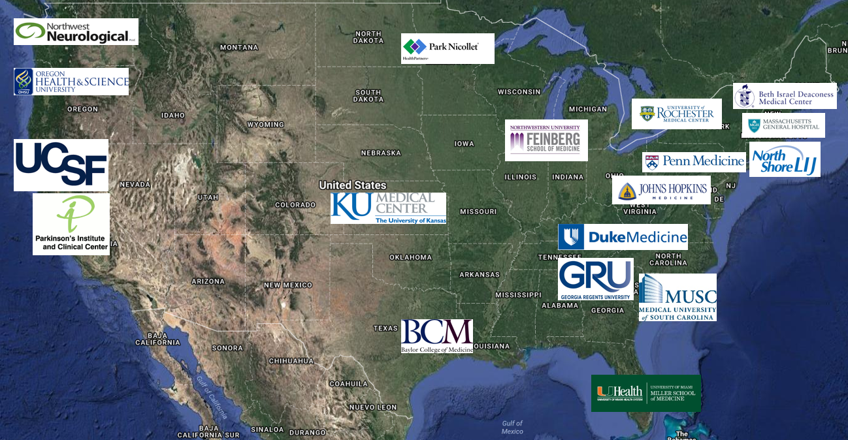
The study was national in scope
In collaboration with:
Source: Connect.Parkinson study

Slide 11
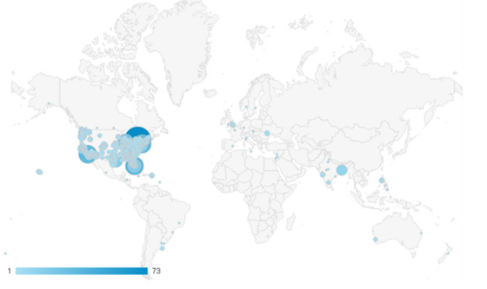
Over 11,000 individuals from 80 countries and 50 states visited the study website
Map of visitors to Connect.Parkinson website
Source: Connect.Parkinson study

Slide 12
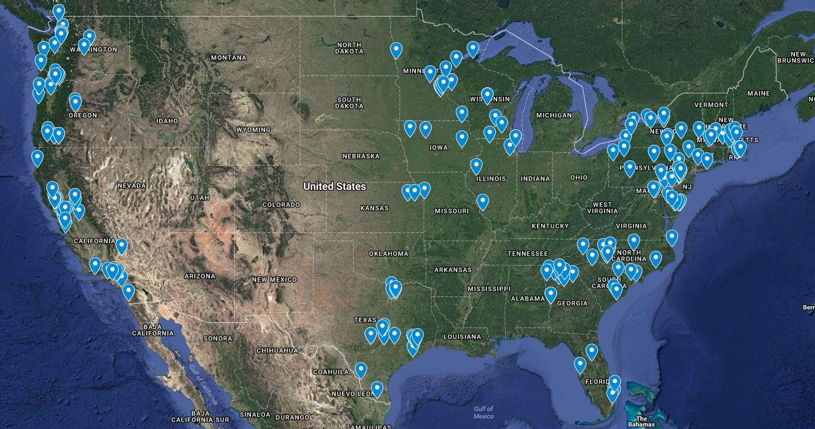
Ultimately, 195 individuals were randomized across 18 sites
Map of Connect.Parkinson participants
Source: Connect.Parkinson study

Slide 13
Participants were well educated and likely receiving good care
Connect.Parkinson participant baseline data
 | All randomized participants (n = 195) | Virtual house calls (n=97) | Usual care (n=98)
Demographics
Age as of screening , [mean (SD)] | 66.4 (8.1) | 65.9 (7.8) | 66.9 (8.5)
Women [n (%)] | 91 (46.7) | 49 (50.5) | 42 (42.8)
White [n (%)] | 187 (95.9) | 92 (94.9) | 95 (96.9)
Bachelor’s degree or higher education, [n (%)] | 143 (73.3) | 71 (73.2) | 72 (73.5)
Internet use and familiarity
Participants that use the internet or email at home [n (%)] | 187 (95.9) | 95 (97.9) | 92 (93.9)
Participants that have ever used their desktop or laptop computer to participate in a video call or video chat [n (%)] | 105 (53.8) | 43 (44.3) | 62 (63.3)
Clinical characteristics
Parkinson disease duration – year (n = 185) | 8.0 (5.6) | 8.3 (6.15) | 7.6 (4.9)
Parkinson disease care
Participants that have seen a Parkinson disease specialist in the last 12 months [n (%)] | 143 (73.3) | 64 (66.0) | 79 (80.6)
Participants that were satisfied or very satisfied with care they received at last visit [n (%)] | 160 (82.5) | 79 (81.4) | 81 (83.5)
Source: Connect.Parkinson study

Slide 14
Providing care via telemedicine is feasible but did not significantly impact quality of life or care
Primary and secondary outcome measures
Feasibility
Out of the 97 individuals randomized to receive virtual house calls, 95 completed at least one virtual house call (98%)
Of the total 388 virtual house calls, 91% were completed as scheduled
Quality of life
Evaluated using the Parkinson Disease Questionnaire 39 (PDQ-39)
Between the two groups there was no significant change in the PDQ-39 as the mean difference was 0.3 points (p = 0.78)
Quality of care
Evaluated using the Patient Assessment of Chronic Illness Care (PACIC)
Between the two groups there was no significant change in the PDQ-39 as the mean difference was 0.0 points (p = 0.79)
Value
Each virtual house call saved patients an average of 169 minutes (p < 0.0001)
Each virtual house call saved patients an average of 56 miles per visit (p < 0.0001)
Source: Connect.Parkinson study

Slide 15
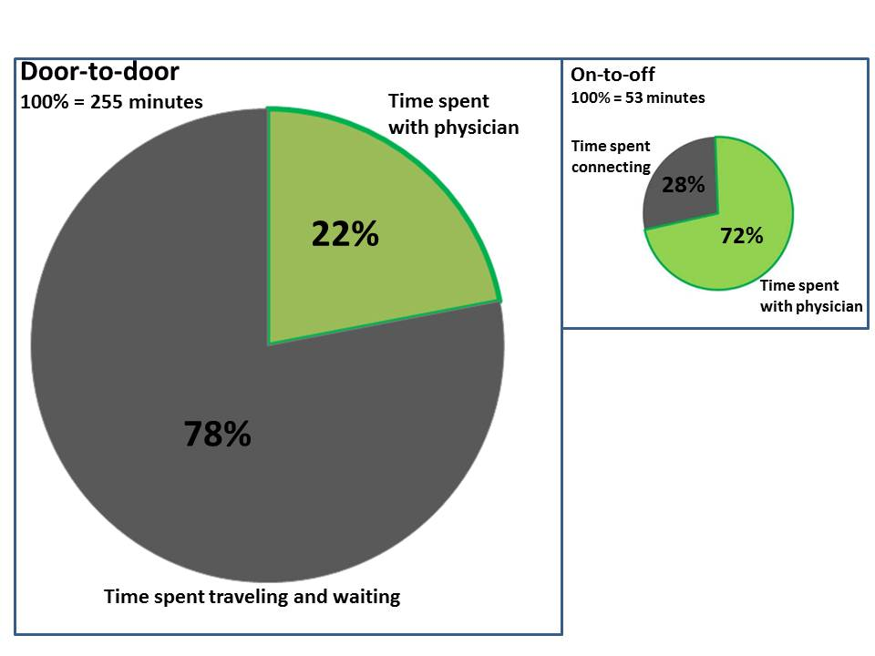
Virtual visits flip the care paradigm
Patient time spent on in-person versus telemedicine visits
Source: JAMA Neurology 2013;70:565-70.
Notes:
Source: abstract

Slide 16
Patients receiving virtual house calls indicated a greater improvement in their PD overall
Patient Global Impression of Change
p = 0.0039
Source: Connect.Parkinson study

Slide 17
Physicians were generally satisfied but had concerns about the quality of the connection
Provider satisfaction with virtual house calls (n = 361)
Source: Connect.Parkinson study

Slide 18
Patients were very satisfied with virtual house calls
Patient satisfaction with virtual house calls (n = 320)
Source: Connect.Parkinson study

Slide 19
Patients found care, convenience, and comfort in virtual house calls
Selected patient feedback
Care
“With the virtual visit, I am asked questions and given a more thorough, longer lasting visit. I like the doctor and have more faith in his philosophy. He listens and asks more questions. I feel like I am getting better care from my virtual visits.”
“Excellent help accompanied by warmth, compassion and expertise.”
Convenience
“I love everything about it! It is difficult for me to get to town. It is not worth while for me to take half day to go to town to visit a doctor who would spend less than 5 minutes…I finally gave up…I really hope [this] becomes one of the standard methods of providing treatment for Parkinson patients…Not having to drive and sit for long periods of time in waiting room is a BIG bonus.”
“The excellent expertise of my doctor and the relaxed atmosphere encourage an in depth conversation that is sometimes more difficult in a hospital/office setting. It encourages note taking that I don't consider doing elsewhere. I like this approach very much.”
“I find it easier to be more comfortable expressing my PD via a remote device than I do during a face-to-face visit.”
Comfort
Source: Connect.Parkinson study

Slide 20
Physicians and patients felt connected to one another
Feedback from a Connect.Parkinson physician
“…evidence of the patient-physician bond that can be established using telemed is that we both had great difficulty saying 'goodbye'. He asked for another visit, and it was so hard to say there would be no more. I felt as if I were abandoning him.”
– Doctor participating in the Connect.Parkinson study
Source: Connect.Parkinson study

Slide 21
Patients preferred virtual house calls to in-person visits on a variety of aspects
Participants relative preference of virtual house calls (n = 68)
Better personal connection
Source: Connect.Parkinson study

Slide 22
Connect.Parkinson met most, but not all of the Institute of Medicine’s six aims for improving healthcare
Crossing the Quality Chasm
Six aims | Connect.Parkinson
Safe | Yes
Effective | Yes
Patient-centered | Yes
Timely | Yes
Efficient | Yes
Equitable | No

Slide 23
The digital divide is the biggest barrier to providing equitable care via telemedicine
Characteristics of Connect.Parkinson population vs. general US population
 | Connect.Parkinson | General population
Age [n (%)] | 66.4 | 36.8
Women [n (%)] | 47% | 51%
Bachelor’s degree or higher education[n (%)] | 73% | 32%
White [n (%)] | 96% | 77%
Use the internet or email at home [n (%)] | 96% | 84%
Sources: https://www.census.gov/hhes/socdemo/education/data/cps/2014/tables.html, http://www.census.gov/quickfacts/table/PST045215/00, Pew Internet & American Life Project question database, Connect.Parkinson study

Slide 24
We recently launched PDCNY to enable any New Yorker with Parkinson Disease to receive care from us
Who: Any New Yorker with Parkinson disease
What: Multidisciplinary care + optional use of smartphone to track disease
When: May 2016
Where: New York state, especially the 9 counties surrounding Rochester
Why: To provide comprehensive care to New York residents, especially the underserved
How much: Free
Supported by: Greater Rochester Health Foundation and the Safra Foundation
For more information: www.pdcny.org

Slide 25
Outline
The need for telehealth
Our work
Policy barriers

Slide 26
Policy barriers prevent broader implementation of telehealth
Reimbursement
Limited and fragmented insurance coverage of telehealth, specifically for Medicare beneficiaries and the privately insured
Legal
State licensure laws prevent providers from seeing patients outside the state they are licensed
States differ in regard to which services physicians can provide remotely
Clinical
Some states require that any care provided via telehealth must be preceded by in-person care

Slide 27
The government has addressed these barriers for the Veterans Health Administration (VHA) but not for Medicare
Overview of VA and Medicare telehealth activities
 | VHA | Medicare
Budget | $60 billion | $646 billion
Beneficiaries | 7 million | 56 million
Money spent on telehealth services | $1.1 billion | $0.02 billion
Telehealth related claims | 2,000,000 | 270,000
Covers telehealth services in-home | Yes | No
Requires clinicians to be licensed in state | No | Yes
Sources: https://www.va.gov/budget/docs/summary/Fy2017-BudgetInBrief.pdf, https://www.healthcarelawtoday.com/2016/03/03/medicare-payments-for-telehealth-increased-25-in-2015-what-you-need-to-know/, https://fas.org/sgp/crs/misc/R43579.pdf

